Slide 1
Spring Boot Series – Day 5
Topic: Spring Boot Actuator
@CodeByHaindavi | #SpringWithMe

Slide 2
Why Go Beyond Basic Annotations?
✔️ Spring Boot apps aren't just wired — they serve web requests, talk to databases, and handle real-time workloads.
✔️ To do all this, Spring Boot provides more powerful annotations — for REST APIs, JPA, caching, and async tasks.
✔️ These annotations don't just reduce boilerplate — they unlock powerful features in just a few words.
✔️ Today, we’ll explore those real-world helpers that make your code production-ready.
@CodeByHaindavi | #SpringWithMe

Slide 3
@RestController – Talk JSON, Not HTML
✔️ Used to build RESTful APIs — it tells Spring that this class will return data, not views.
✔️ It’s a combo of @Controller + @ResponseBody.
✔️ Spring doesn't try to render a JSP or Thymeleaf view — it directly sends the return object as JSON.
✔️ Perfect for APIs used by frontends or mobile apps.
Example: @RestController public class BookController { @GetMapping("/books") List<Book> getAll() {…} }
@CodeByHaindavi | #SpringWithMe

Slide 4
Mapping Requests Made Simple
✔️ @GetMapping, @PostMapping, @PutMapping, @DeleteMapping are modern shortcuts to map HTTP methods.
✔️ They replace older verbose @RequestMapping(method = …) style.
✔️ Example: @PostMapping("/users") means this method handles POST requests to /users.
✔️ Clean, readable, and follows REST principles.
@CodeByHaindavi | #SpringWithMe

Slide 5
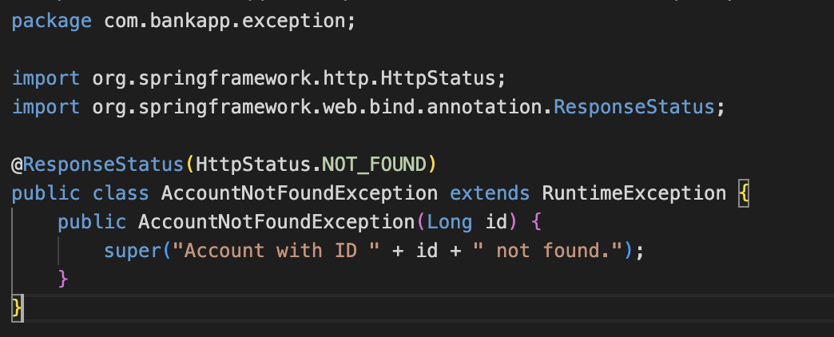
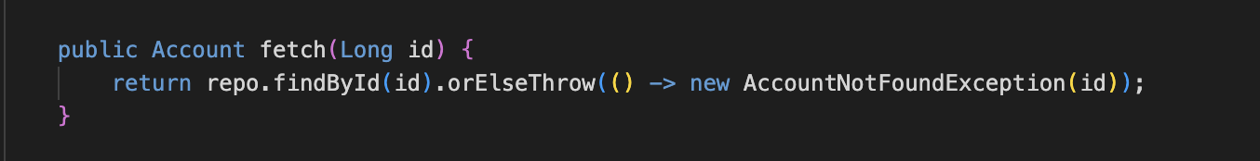
Making APIs Friendly – Errors, CORS, Validation
✔️ @ResponseStatus lets you return custom HTTP status codes.
Defines a custom exception with HTTP 404 status, thrown when an account is not found.
If no account is found, this method throws AccountNotFoundException to trigger a 404 response.
@CodeByHaindavi | #SpringWithMe

Slide 6
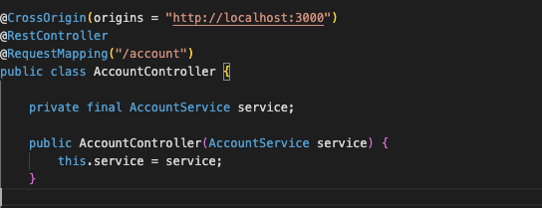
Making APIs Friendly – Errors, CORS, Validation
✔️ @CrossOrigin is vital for letting frontend apps (like React) call your backend.
Allows frontend apps (like React running on localhost:3000) to access these APIs without CORS errors.
@CodeByHaindavi | #SpringWithMe

Slide 7
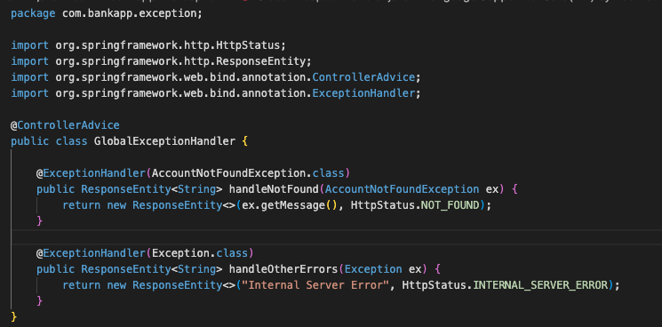
Making APIs Friendly – Errors, CORS, Validation
✔️ @ControllerAdvice + @ExceptionHandler = global error handler. One place to catch all exceptions.
Centralized handler that catches exceptions like AccountNotFoundException and returns clean HTTP responses.
@CodeByHaindavi | #SpringWithMe

Slide 8
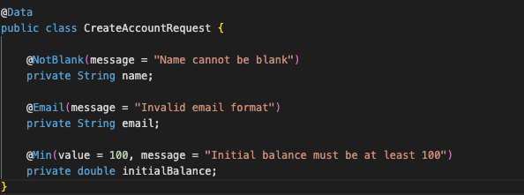

Making APIs Friendly – Errors, CORS, Validation
✔️ @Valid ensures user input is validated — works with annotations like @NotNull or @Email on DTOs.
Defines validation rules for incoming account data using annotations like @NotBlank, @Email, and @Min.
This controller method validates the request body before calling the service. If input is invalid, Spring auto-returns a 400 error with messages.
@CodeByHaindavi | #SpringWithMe

Slide 9
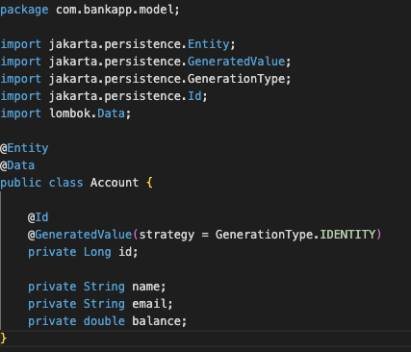
JPA – Turning Classes into Tables
✔️ @Entity marks a class to be saved to a DB table.
✔️ @Id marks the primary key, and @GeneratedValue handles auto-increment.
✔️ @Column customizes field-to-column mapping.
✔️ No need to write SQL – just define the object, Spring + Hibernate do the rest.
This entity maps to a database table — Spring Data JPA uses annotations to auto-generate schema and handle persistence.
@CodeByHaindavi | #SpringWithMe

Slide 10
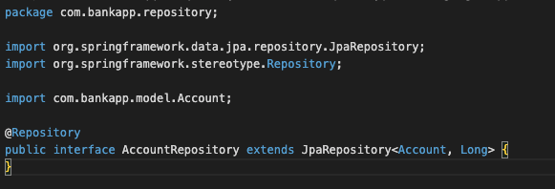
@Repository – Your Gateway to Data
✔️ Marks a class that talks to the database.
✔️ Works with Spring Data JPA interfaces like JpaRepository.
✔️ Spring generates all the common DB methods for you: save, findAll, findById, delete…
✔️ No need to write even a single SQL query unless you want to.
This interface connects to the database using Spring Data JPA — no SQL or implementation needed.
@CodeByHaindavi | #SpringWithMe

Slide 11

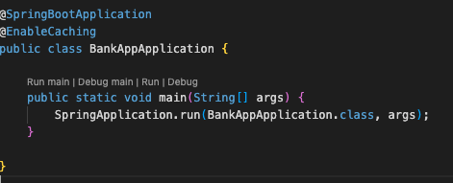
Performance Boost – @Cacheable and Friends
✔️ @EnableCaching turns on cache support.
✔️ @Cacheable stores method results — so next call is instant.
✔️ @CachePut updates cache after changes.
✔️ @CacheEvict clears stale data.
✔️ Used smartly, this can reduce DB load dramatically.
The same fetch() method is now enhanced with @Cacheable — returning results from cache if already available.
@CodeByHaindavi | #SpringWithMe

Slide 12
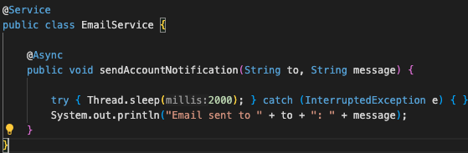
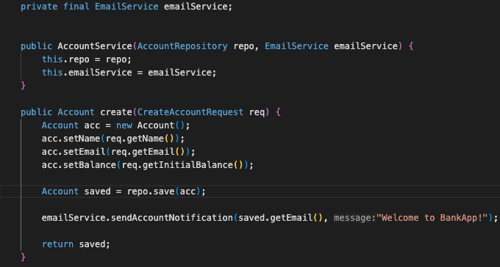
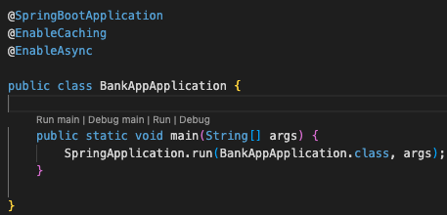
Run in Background – @Async
✔️ Some tasks don’t need to block the user — like sending emails.
✔️ @Async makes a method run in a separate thread.
✔️ Add @EnableAsync to activate it globally.
✔️ This keeps apps responsive and fast even during long tasks.
Enables background processing by making the email notification run on a separate thread.
@CodeByHaindavi | #SpringWithMe

Slide 13
💼 Interview Insight
How do @ControllerAdvice and @ExceptionHandler help in building robust REST APIs?
• They enable centralized exception handling across multiple controllers.
• @ExceptionHandler methods catch specific exceptions like
AccountNotFoundException, MethodArgumentNotValidException, etc.
• With @RestControllerAdvice, JSON error responses can be customized globally (instead of duplicating try-catch logic).
• Internally, Spring uses ExceptionHandlerExceptionResolver to map exceptions to handlers.
Why do we extend JpaRepository in Spring Boot, and what benefits does it provide?
• Extending JpaRepository gives you built-in CRUD operations like save(), findById(), delete() without writing SQL. • It also supports custom finder methods using naming conventions (e.g., findByEmail).
@CodeByHaindavi | #SpringWithMe

Slide 14
📌 Hands-On Tip
✔️ Create two beans of the same type and try injecting them without @Qualifier.
✔️ Write a custom exception and return it from a controller — then handle it globally using @ControllerAdvice.
✔️ Temporarily remove @EnableAutoConfiguration (or comment out @SpringBootApplication) and observe how the app behaves.
@CodeByHaindavi | #SpringWithMe

Slide 15
📌 Recap – Day 4
✔️ We moved beyond wiring annotations and explored how Spring Boot annotations make real-world features easy and powerful. ✔️ You learned how to handle web requests, validate inputs, manage exceptions, and build cleaner APIs using annotations like @RestController, @Valid, @ExceptionHandler, and more. ✔️ We mapped Java objects to database tables using @Entity, accessed data with @Repository, and injected values using both @Value and @ConfigurationProperties. ✔️ We also saw how to boost performance with @Cacheable, run tasks asynchronously with @Async, and connect frontend-backend with @CrossOrigin.
👉 Coming up next: Spring Boot Actuator✨
@CodeByHaindavi | #SpringWithMe

